Slide 1
Jennifer Rogers and Robbie Weber

Slide 2
Workshop Goals
Improve happiness productivity
Solve multi-building cultural problems
Increase collaboration
Improve state of the art of fundamental computer science topics

Slide 3
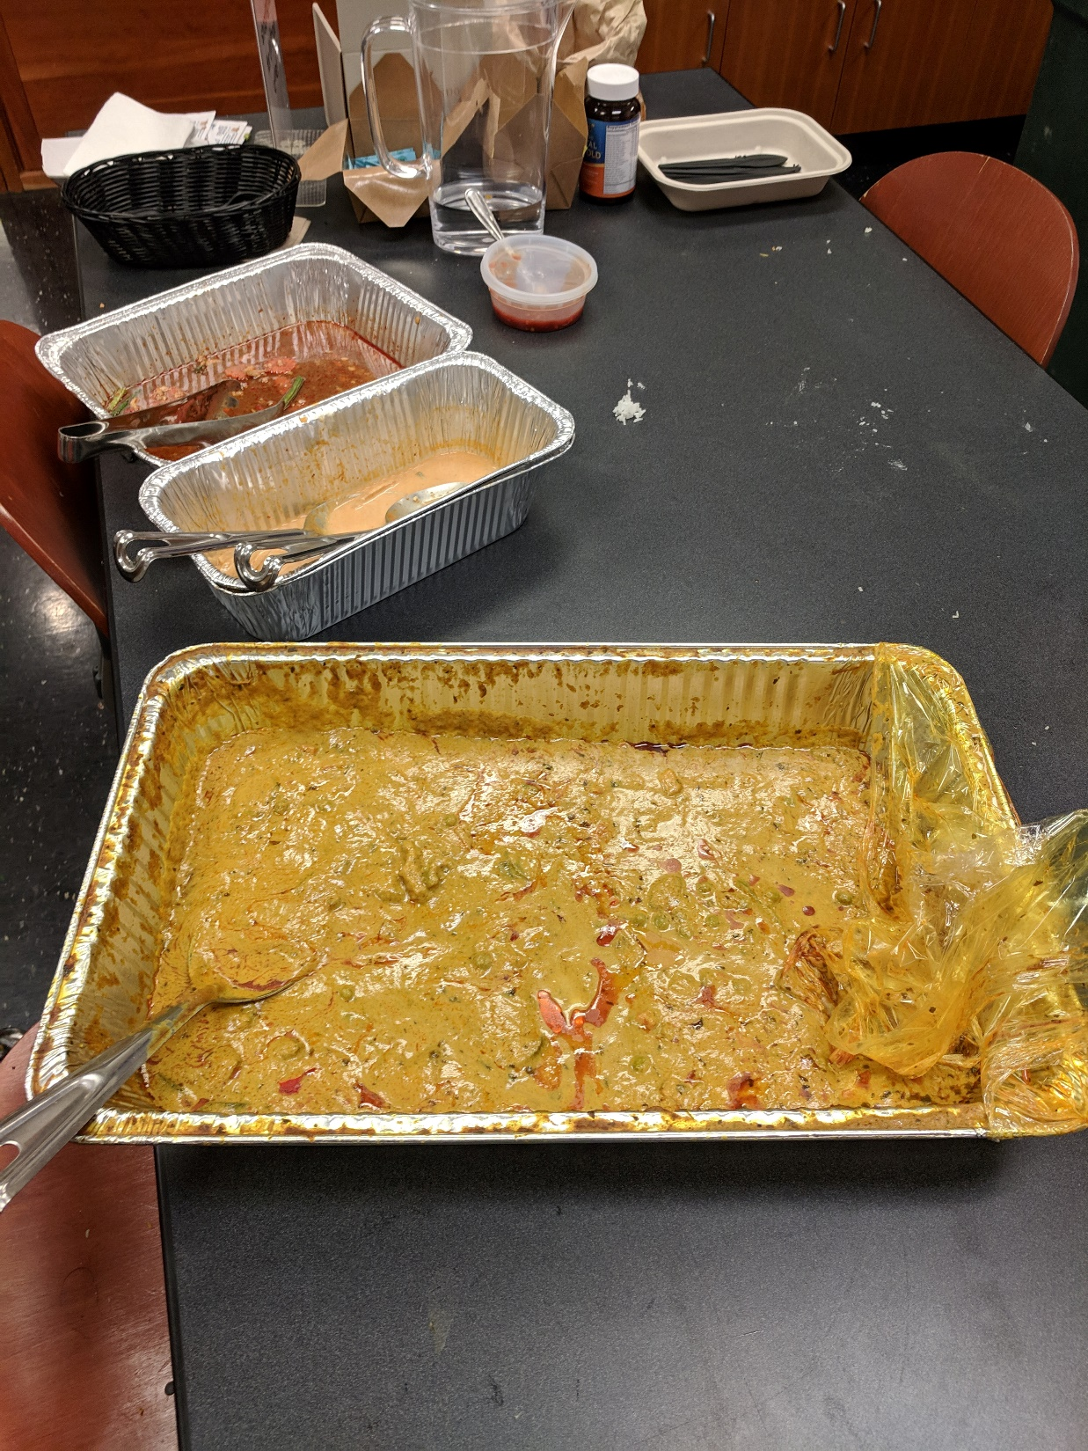
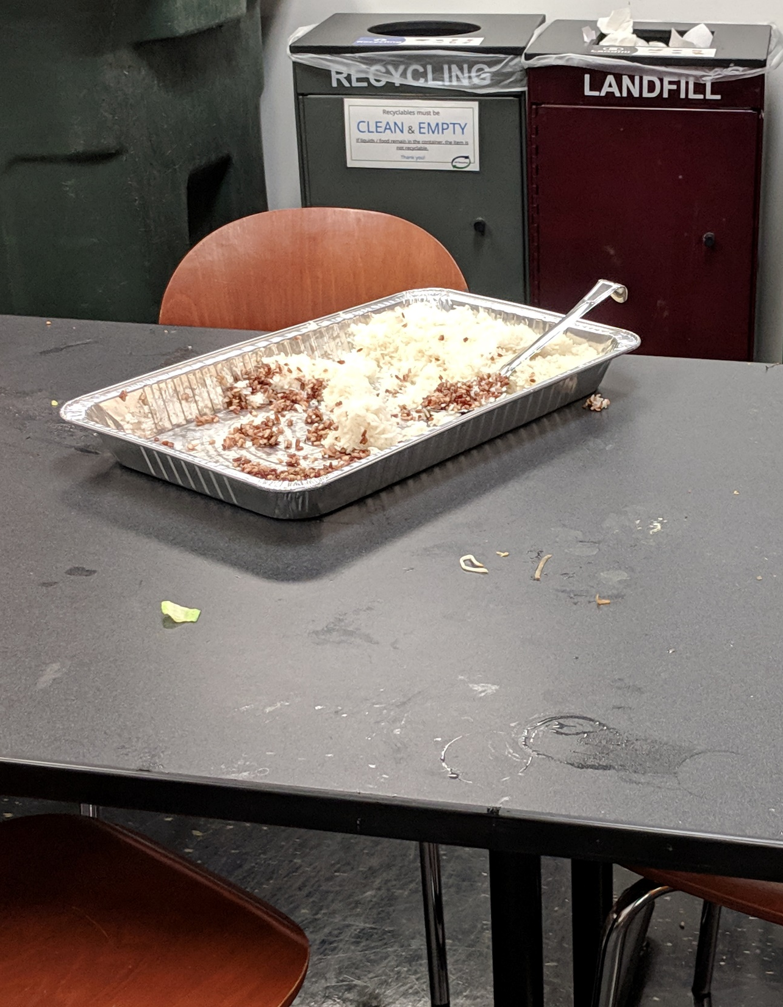

Slide 4

Rice/Curry Problem
Leads to grad students who are
Hungry
Sad
Inefficient

Slide 5
Prior Solutions
Ad hoc
Eat bland rice/Drink curry?
Store some in the fridge
Not scalable
Sophie will yell at us for wasting fridge space
Provably suboptimal

Slide 6
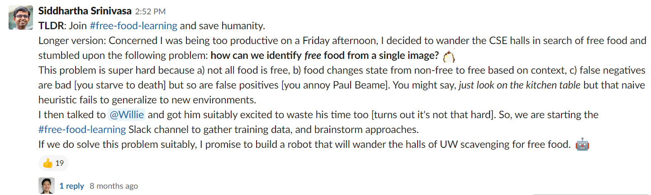
Prior Solutions
Lacked collaboration.

Slide 7

We need experts in:
Robotics
Vision
Machine Learning
Theory
AND MORE

Slide 8

WORC
2019

Slide 9
WORC Submission
Send your results to
mwillsey@cs.washington.edu
Review process will be
Rigorous (no)
Single-Blind (if you use a burner email address)
Multi-stage (0 stages counts as multi-stage, right?)

Slide 10
You’re not making a PoCSci talk
WORC
2019
You’re WORCing

